Slide 1









STUDENT NAME : VIDHYA LAKSHMI.G
REGISTER NO : 312210384
NM ID : 2C29432AE41A0E69D4E4512DB63335B1
DEPARTMENT : BACHELOR OF COMMERCE
COLLEGE : GURU SHREE SHANTIVIJAI JAIN COLLEGE FOR WOMEN

Slide 3


Problem Statement
Project Overview
End Users
Our Solution and Proposition
Dataset Description 6.Modelling Approach
7.Results and Discussion 8.Conclusion
3/21/2024

Slide 4









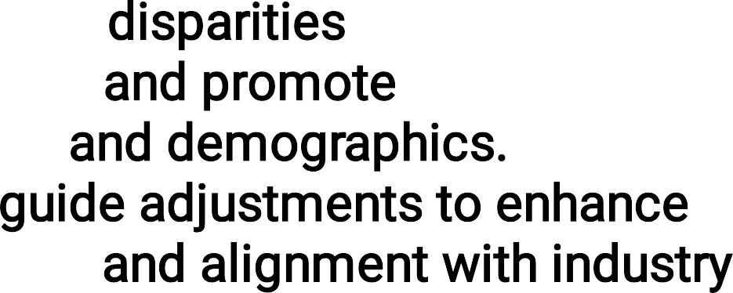

















Slide 5

.It identify trends , disparities , and alignment with industry standards .
The key objectives includes ensuring equitable pay
practices , evaluating the impact of compensation on employee retention , and providing actionable insights for future compensation strategies.
The analysis will guide decision making to enhance
overall employee satisfaction and organization effectiveness.

Slide 6

❖
❖
❖
❖
❖

Slide 7

CONDITIONAL FORMATTING- MISSING FILTER-REMOVE VALUES
FORMULA- SALARY PIVOT-SUMMARY
GRAPH-DATA VISUALIZATION

Slide 8
EMPLOYEE==-EDUNET-DASHBOARD 26-FEATURES
9-FEATURES
EMP ID – IN NUMBER NAME-TEXT
SALARY-IN NUMBER GENDER – MALE,FEMALE
TOTAL SALARY – IN NUMBER

Slide 9

•
TOTAL SALARY ANALYSIS =
SUM(SALARY,NUMBER(SALARY*3%))
3/21/2024

Slide 10
1. IDENTIFY Data source:
•
Gather data from HR system , payroll records and employees database.
2.COLLECT RELEVANT VARIABLES:
Include employees demographic s , job details and salary information.

Slide 11











•
Identify factors like education level , years of experience, performance rating and job role influence salary.
calculate features such as salary rate and compensation as percentage of revenue.

Slide 12
•
Impute remove missing data points ,
especially
In salary or compensation records
Adjust for inconsistencies , such as different units of currency or salary reports standards,
Identify and address outline that could distort the analysis , such as unusually high bonuses or entries

Slide 13
Count of DepartmentType | Column Labels
Row Labels | 10300 | 12360 | 13390 | 15450 | 18540 | 20600 | 30900 | 35020 | 41200 | 51500 | Grand Total
BPC |  | 43 |  | 41 | 3 | 26 | 35 |  | 1 | 1 | 150
CCDR |  | 41 |  | 33 | 8 | 28 | 30 |  | 3 | 2 | 145
EW |  | 42 |  | 40 | 4 | 29 | 34 |  | 2 | 3 | 154
MSC |  | 37 |  | 50 | 7 | 25 | 34 |  | 2 | 2 | 157
NEL |  | 48 |  | 33 | 7 | 30 | 34 |  | 1 | 1 | 154
PL |  | 44 |  | 29 | 8 | 28 | 34 |  |  |  | 143
PYZ |  | 51 |  | 34 | 5 | 30 | 33 |  | 1 | 3 | 157
SVG |  | 56 |  | 39 | 6 | 26 | 35 |  | 1 | 4 | 167
TNS |  | 40 | 1 | 39 | 10 | 32 | 23 |  | 1 | 4 | 150
WBL | 1 | 38 |  | 42 | 6 | 30 | 33 | 1 | 2 | 3 | 156
Grand Total | 1 | 440 | 1 | 380 | 64 | 284 | 325 | 1 | 14 | 23 | 1533
13

Slide 14




SALARY ANALYSIS
60
50
10300
12360
13390
15450
18540
20600
30900
35020
41200
51500
40
30
20
51500
41200
35020
30900
20600
18540
15450
13390
12360
10300
10
0
^{BPC} CCDR
EW
MSC
NEL
PL
PYZ
SVG
TNS
WBL

